Slide 1
SONET/SDH

Slide 2
SONET was developed by ANSI;
SDH was developed by ITU-T.

Slide 3
ARCHITECTURE
Let us first introduce the architecture of a SONET system: signals, devices, and connections.
Topics discussed in this section:
Signals
SONET Devices
Connections

Slide 4
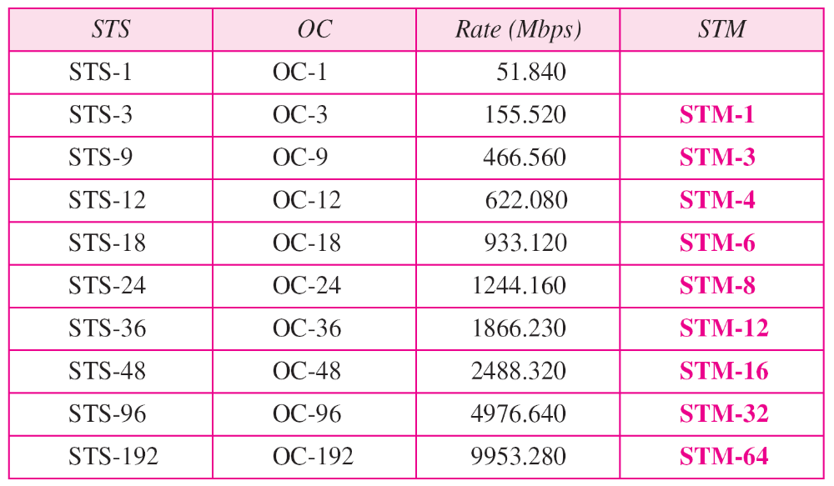
Table 17.1 SONET/SDH rates

Slide 5
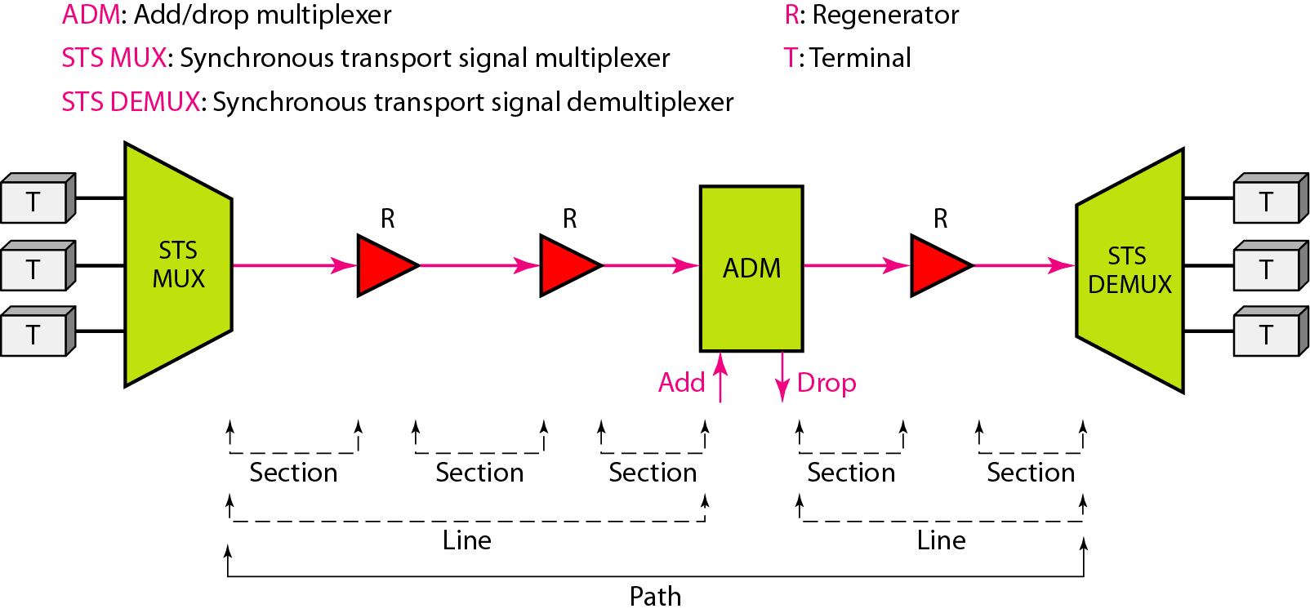
Figure 17.1 A simple network using SONET equipment

Slide 6
SONET LAYERS
The SONET standard includes four functional layers: the photonic, the section, the line, and the path layer. They correspond to both the physical and the data link layers.
Topics discussed in this section:
Path Layer
Line Layer
Section Layer
Photonic Layer
Device–Layer Relationships

Slide 7
SONET defines four layers:
path, line, section, and photonic.

Slide 8
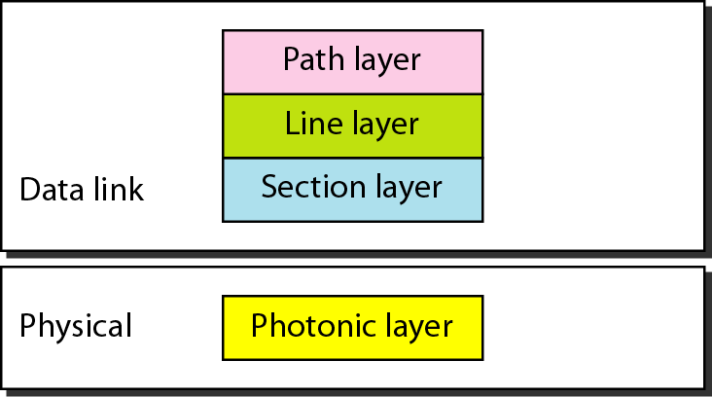
Figure 17.2 SONET layers compared with OSI or the Internet layers

Slide 9
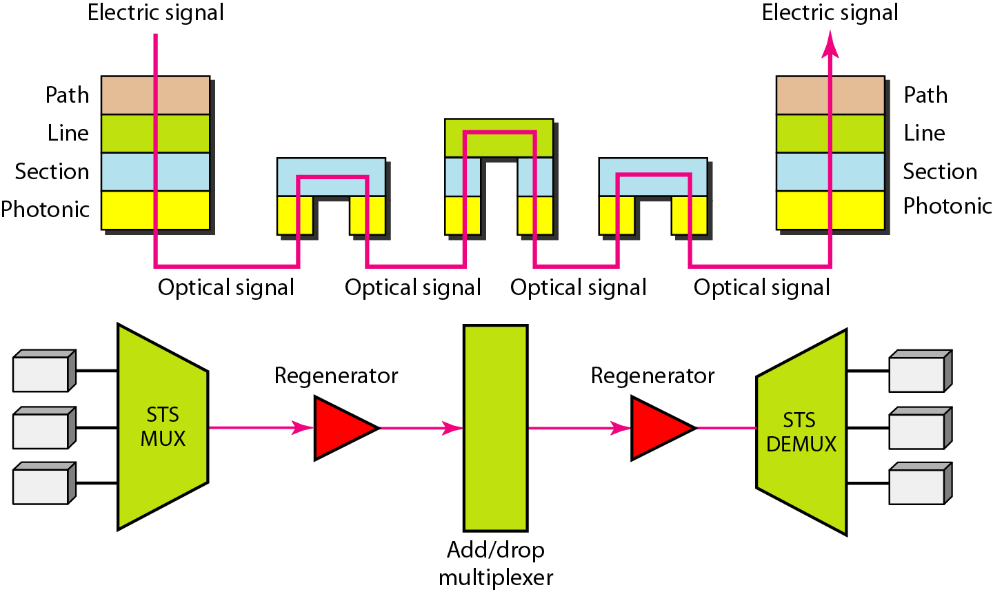
Figure 17.3 Device–layer relationship in SONET

Slide 10
SONET FRAMES
Each synchronous transfer signal STS-n is composed of 8000 frames. Each frame is a two-dimensional matrix of bytes with 9 rows by 90 × n columns.
Topics discussed in this section:
Frame, Byte, and Bit Transmission
STS-1 Frame Format
Encapsulation

Slide 11
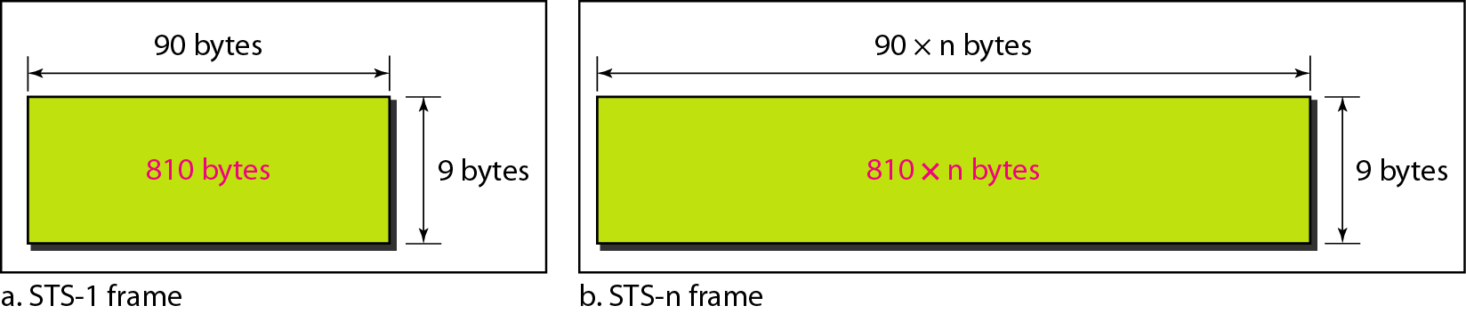
Figure 17.4 An STS-1 and an STS-n frame

Slide 12
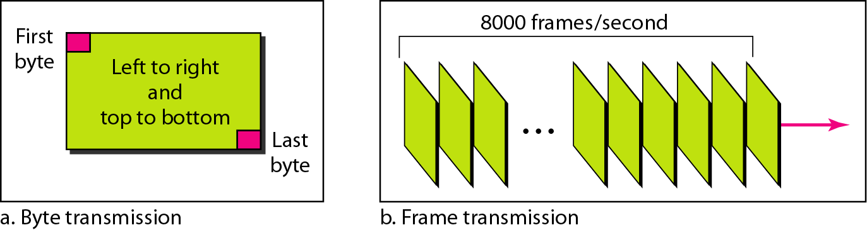
Figure 17.5 STS-1 frames in transmission

Slide 13
A SONET STS-n
signal is transmitted at
8000 frames per second.

Slide 14
Each byte in a SONET frame can carry a digitized voice channel.

Slide 15
Example 1
Find the data rate of an STS-1 signal.
Solution
STS-1, like other STS signals, sends 8000 frames per second. Each STS-1 frame is made of 9 by (1 × 90) bytes. Each byte is made of 8 bits. The data rate is

Slide 16
Example 2
Find the data rate of an STS-3 signal.
Solution
STS-3, like other STS signals, sends 8000 frames per second. Each STS-3 frame is made of 9 by (3 × 90) bytes. Each byte is made of 8 bits. The data rate is

Slide 17
In SONET, the data rate of an STS-n
signal is n times the data rate
of an STS-1 signal.

Slide 18
Example 3
What is the duration of an STS-1 frame? STS-3 frame? STS-n frame?
Solution
In SONET, 8000 frames are sent per second. This means that the duration of an STS-1, STS-3, or STS-n frame is the same and equal to 1/8000 s, or 125 μs.

Slide 19
In SONET,
the duration of any frame is 125 μs.

Slide 20
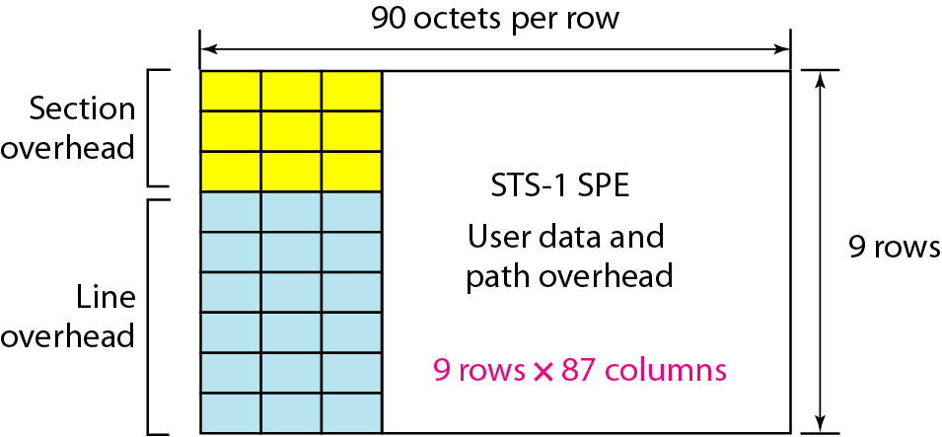
Figure 17.6 STS-1 frame overheads

Slide 21
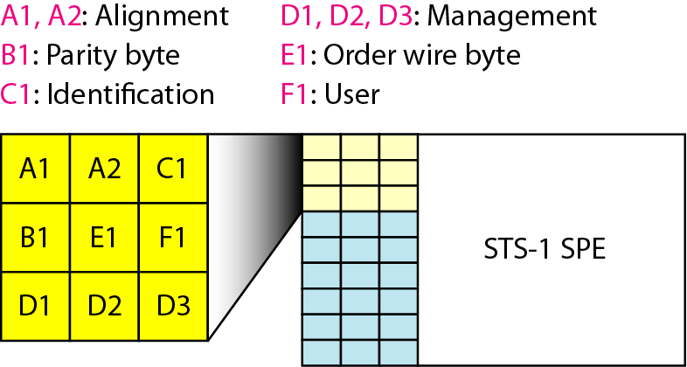
Figure 17.7 STS-1 frame: section overhead

Slide 22
Section overhead is recalculated for each SONET device
(regenerators and multiplexers).

Slide 23
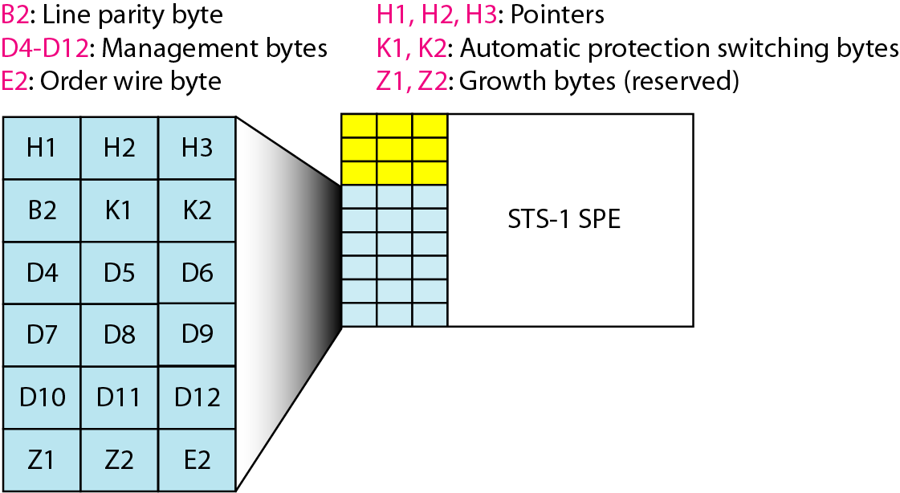
Figure 17.8 STS-1 frame: line overhead

Slide 24
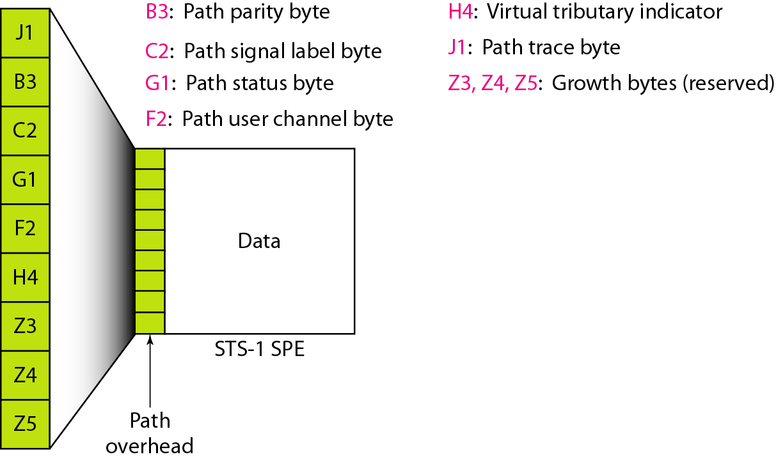
Figure 17.9 STS-1 frame: path overhead

Slide 25
Path overhead is only calculated for end-to-end (at STS multiplexers).

Slide 26
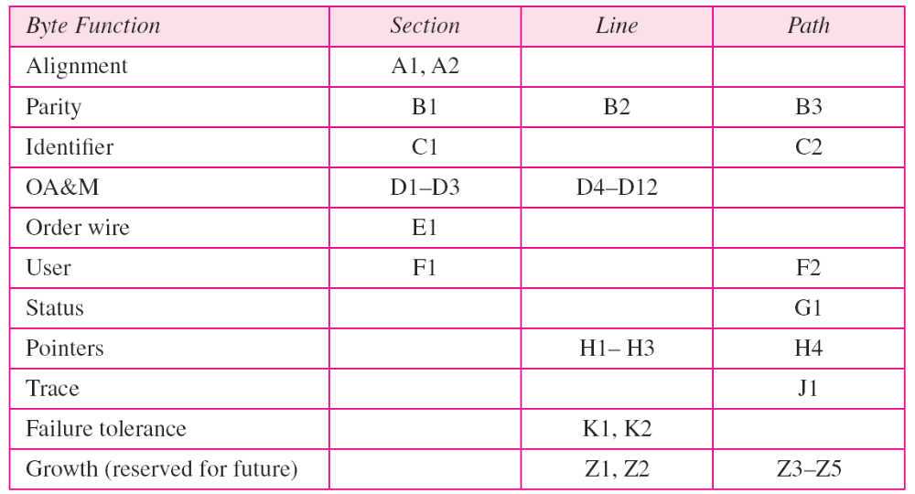
Table 17.2 Overhead bytes

Slide 27
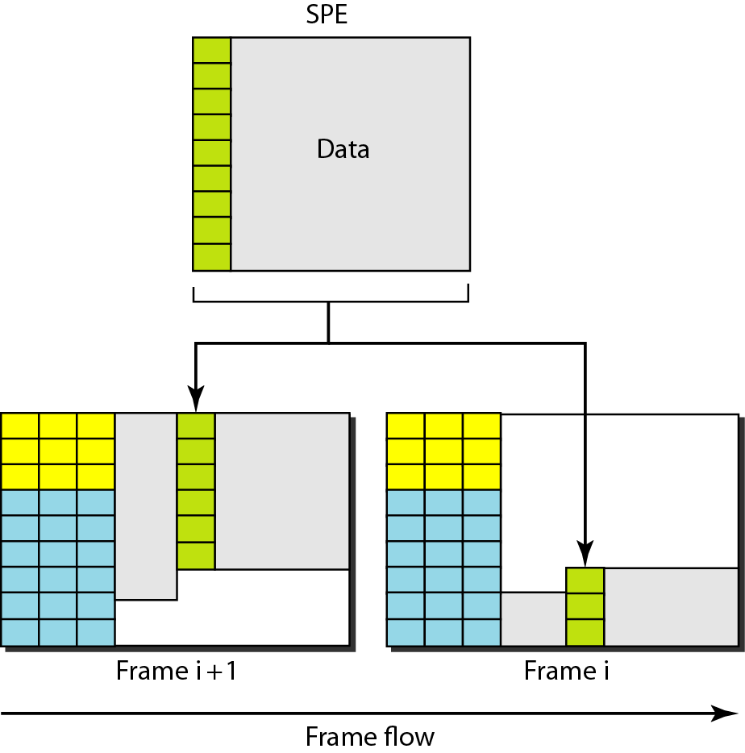
Figure 17.10 Offsetting of SPE related to frame boundary

Slide 28
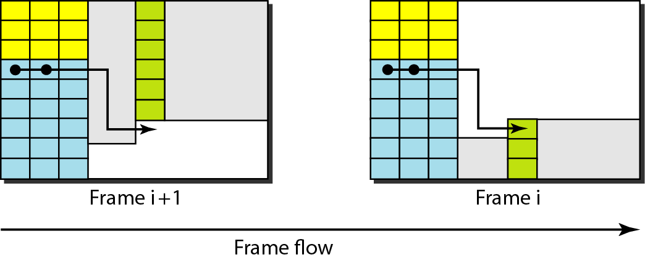
Figure 17.11 The use of H1 and H2 pointers to show the start of
an SPE in a frame

Slide 29
Example 5
What are the values of H1 and H2 if an SPE starts at byte number 650?
Solution
The number 650 can be expressed in four hexadecimal digits as 0x028A. This means the value of H1 is 0x02 and the value of H2 is 0x8A.

Slide 30
STS MULTIPLEXING
In SONET, frames of lower rate can be synchronously time-division multiplexed into a higher-rate frame. For example, three STS-1 signals (channels) can be combined into one STS-3 signal (channel), four
STS-3s can be multiplexed into one STS-12, and so on.
Topics discussed in this section:
Byte Interleaving
Concatenated Signal
Add/Drop Multiplexer

Slide 31
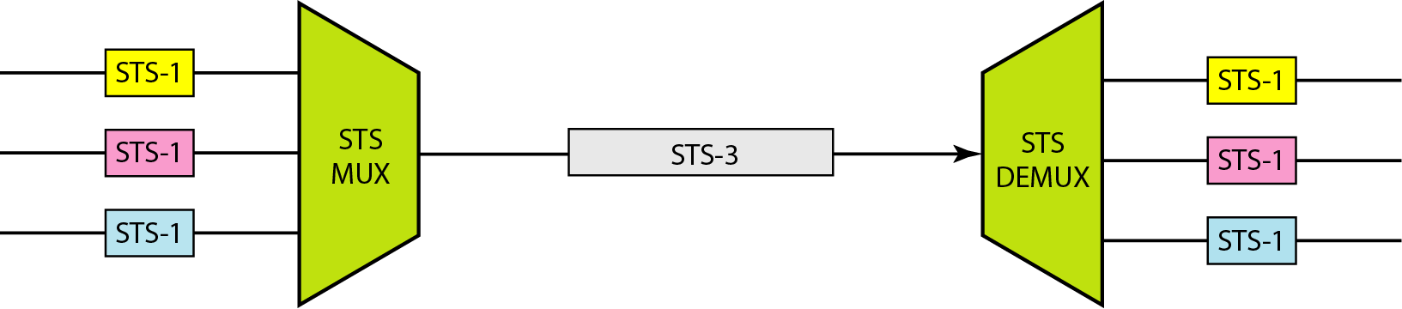
Figure 17.12 STS multiplexing/demultiplexing

Slide 32
In SONET, all clocks in the network are locked to a master clock.

Slide 33
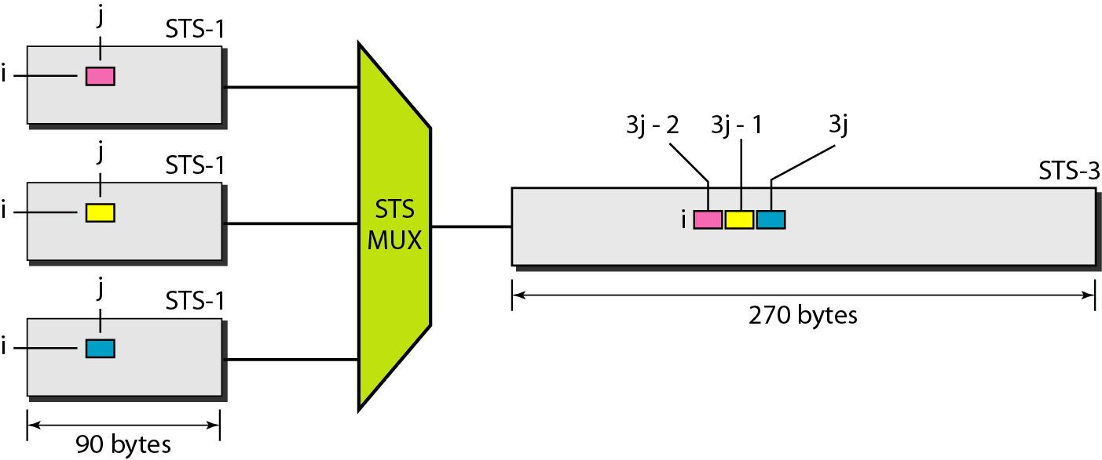
Figure 17.13 Byte interleaving

Slide 34
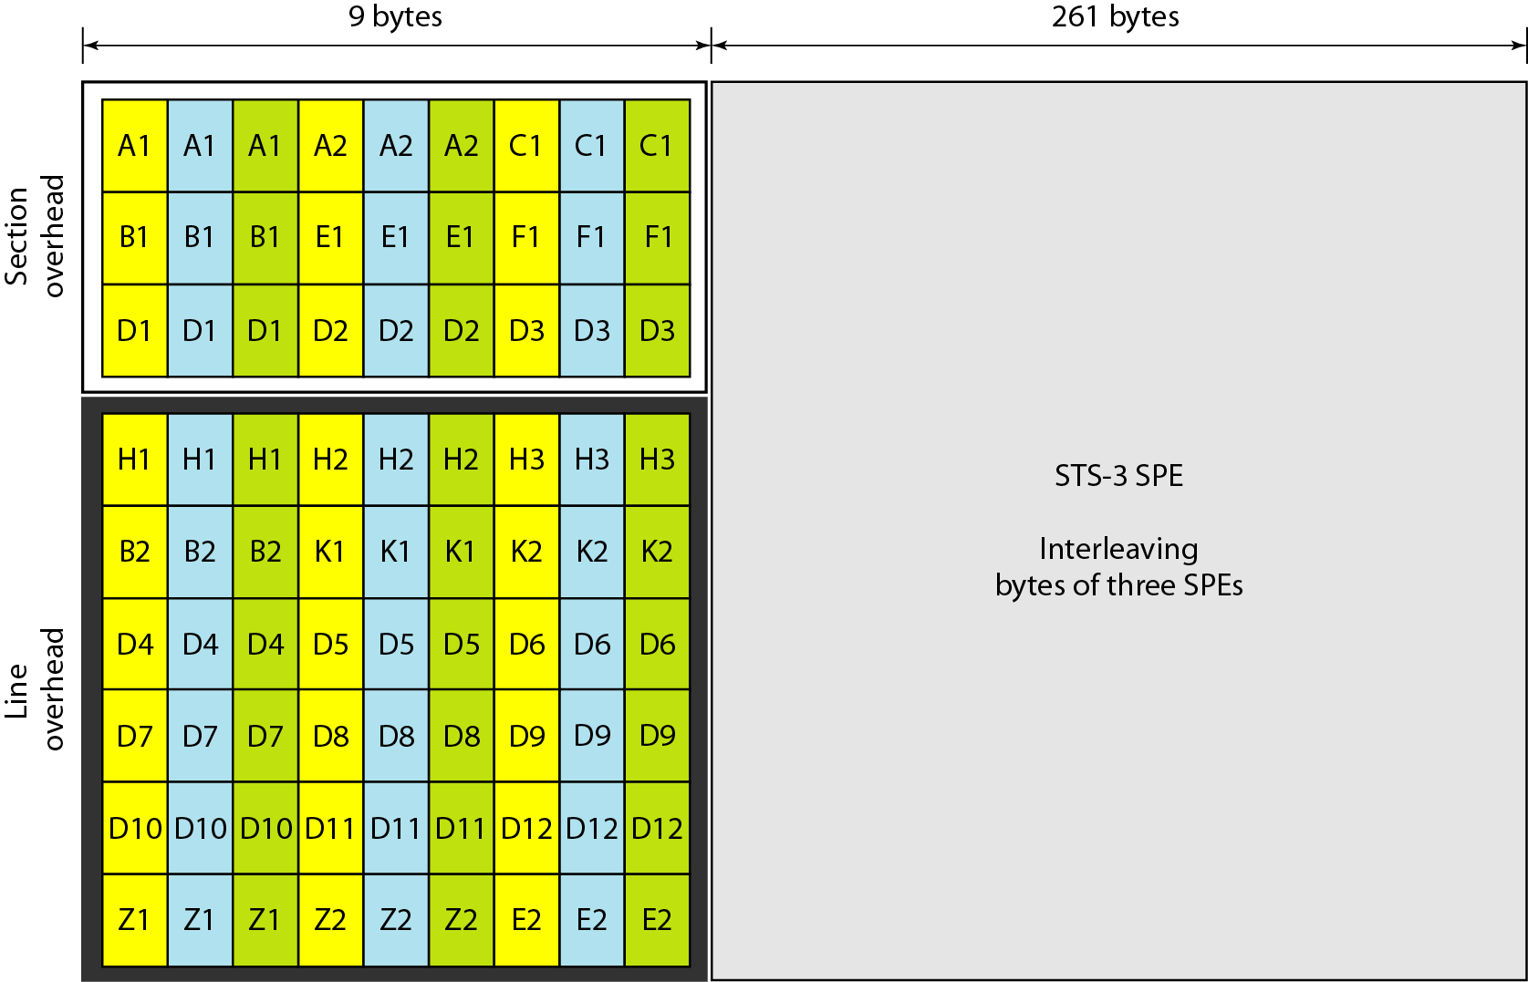
Figure 17.14 An STS-3 frame

Slide 35
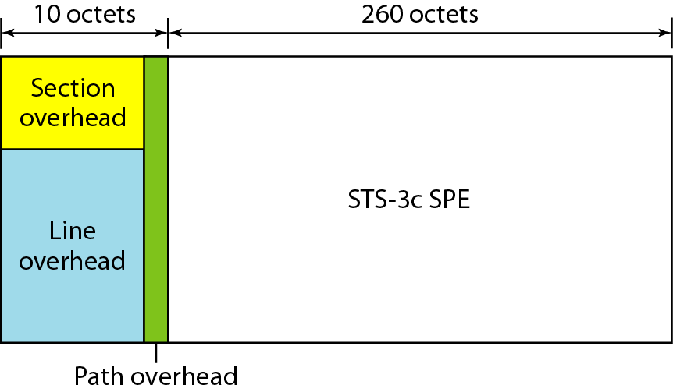
Figure 17.15 A concatenated STS-3c signal

Slide 36
An STS-3c signal can carry
44 ATM cells as its SPE.

Slide 37
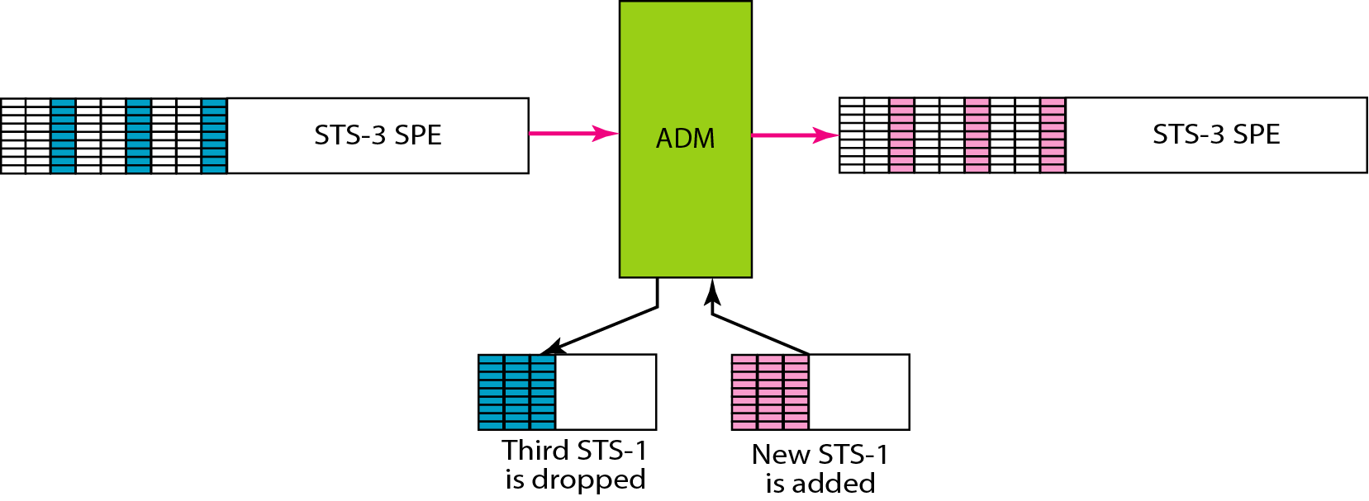
Figure 17.16 Dropping and adding STS-1 frames in an add/drop multiplexer

Slide 38
SONET NETWORKS
Using SONET equipment, we can create a SONET network that can be used as a high-speed backbone carrying loads from other networks. We can roughly divide SONET networks into three categories: linear, ring, and mesh networks.
Topics discussed in this section:
Linear Networks
Ring Networks
Mesh Networks

Slide 39
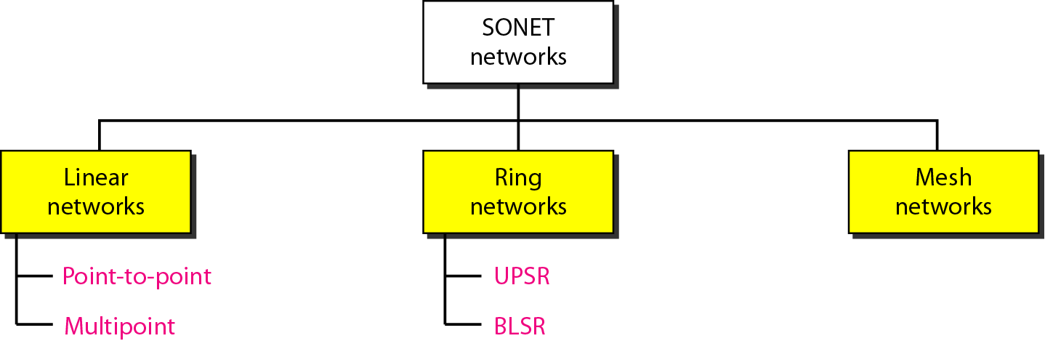
Figure 17.17 Taxonomy of SONET networks

Slide 40
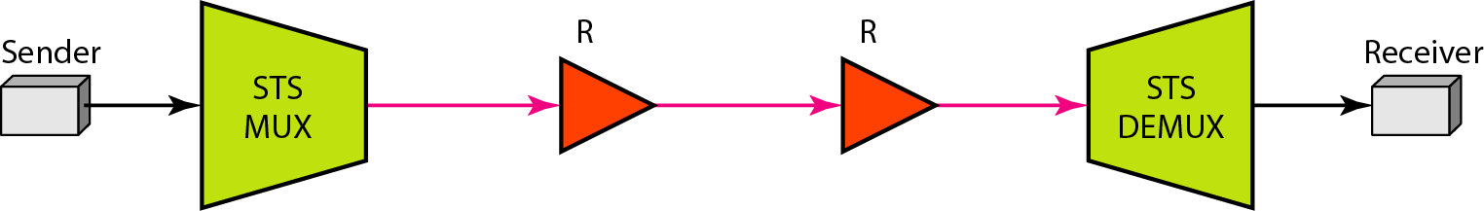
Figure 17.18 A point-to-point SONET network

Slide 41
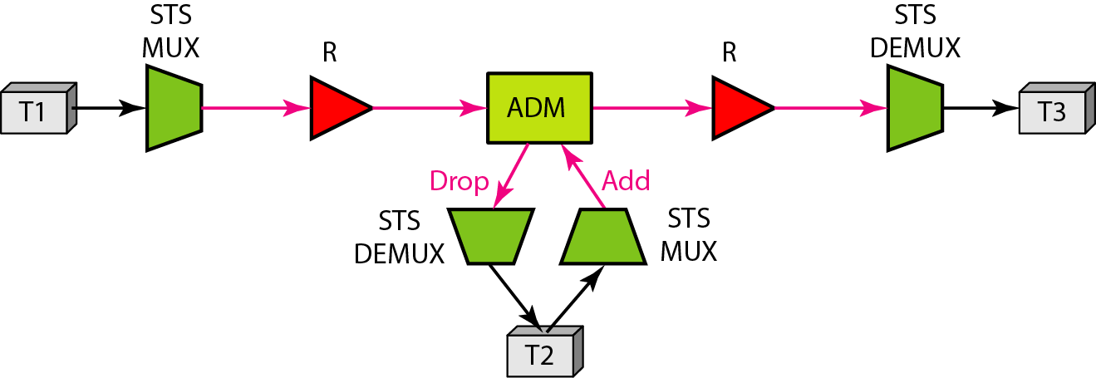
Figure 17.19 A multipoint SONET network

Slide 42
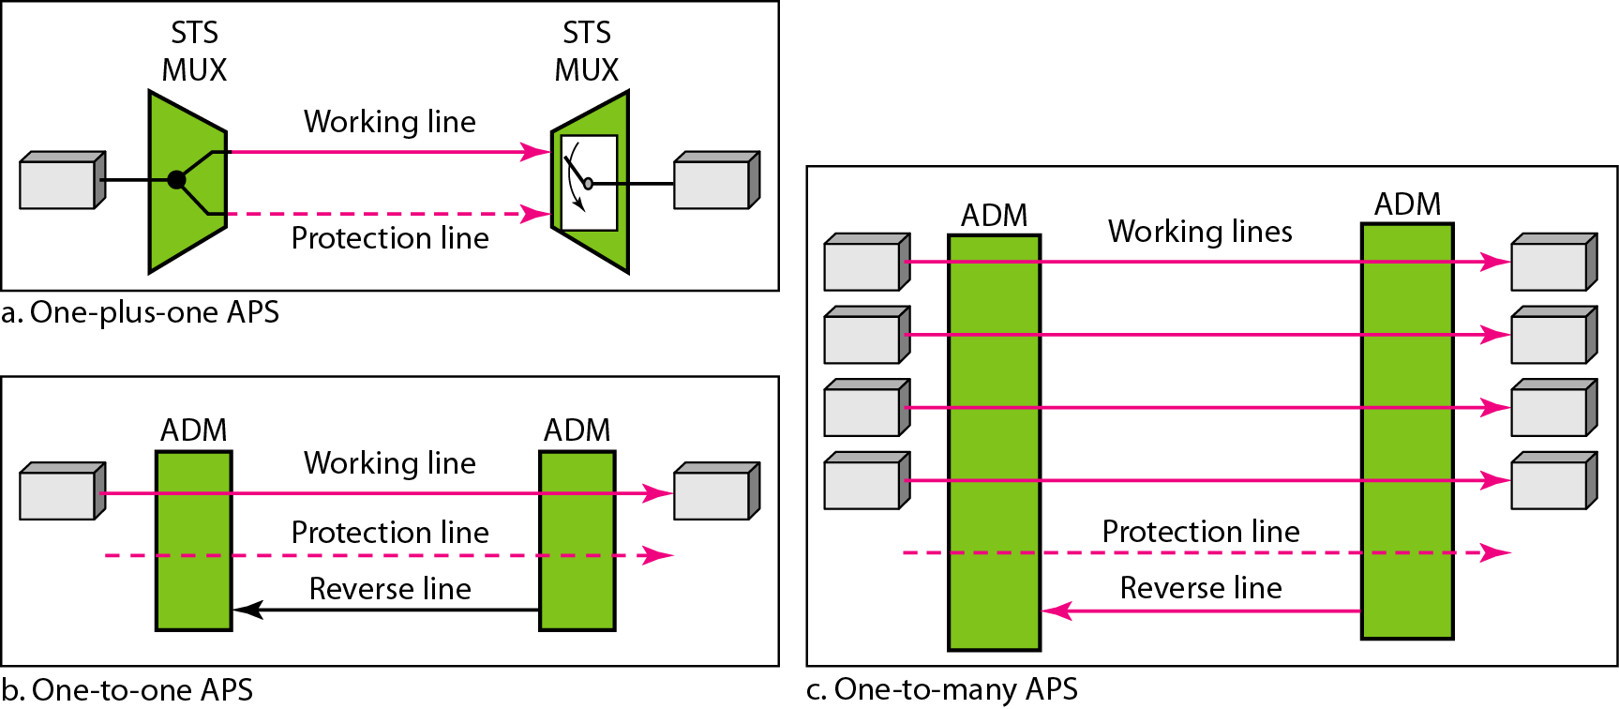
Figure 17.20 Automatic protection switching in linear networks

Slide 43
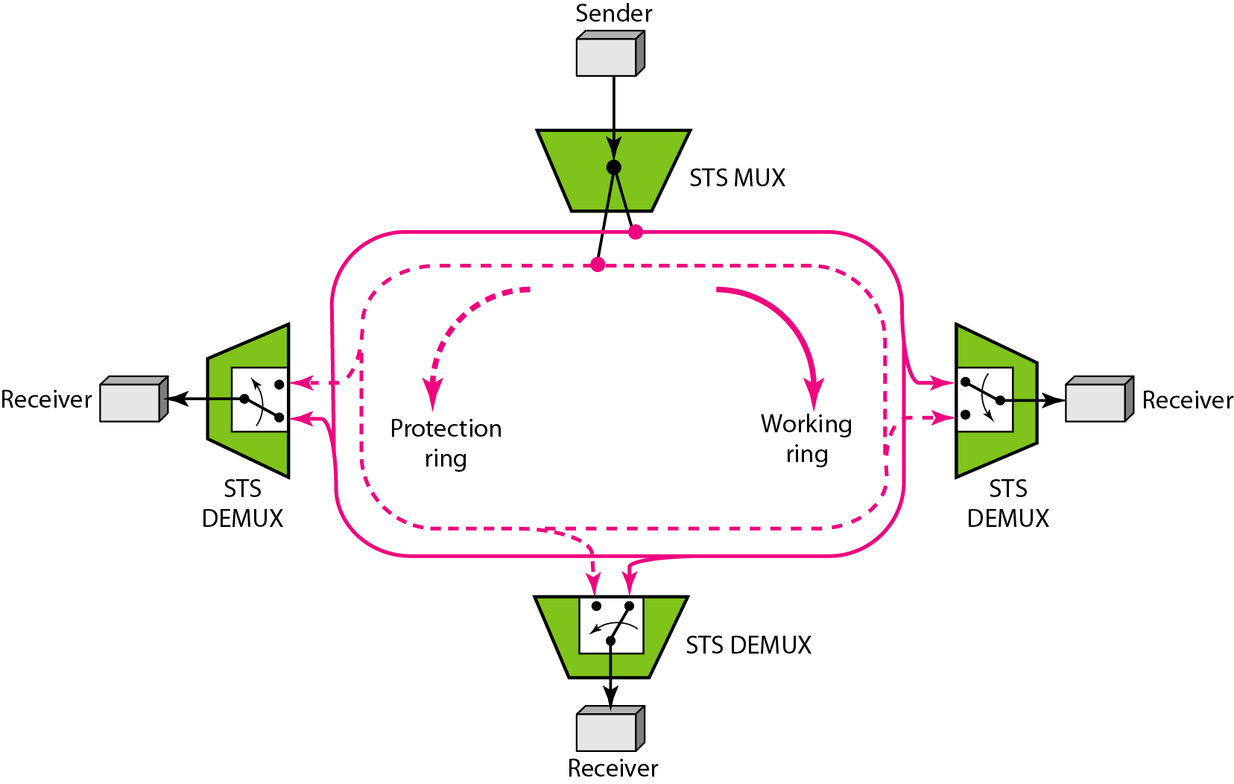
Figure 17.21 A unidirectional path switching ring

Slide 44
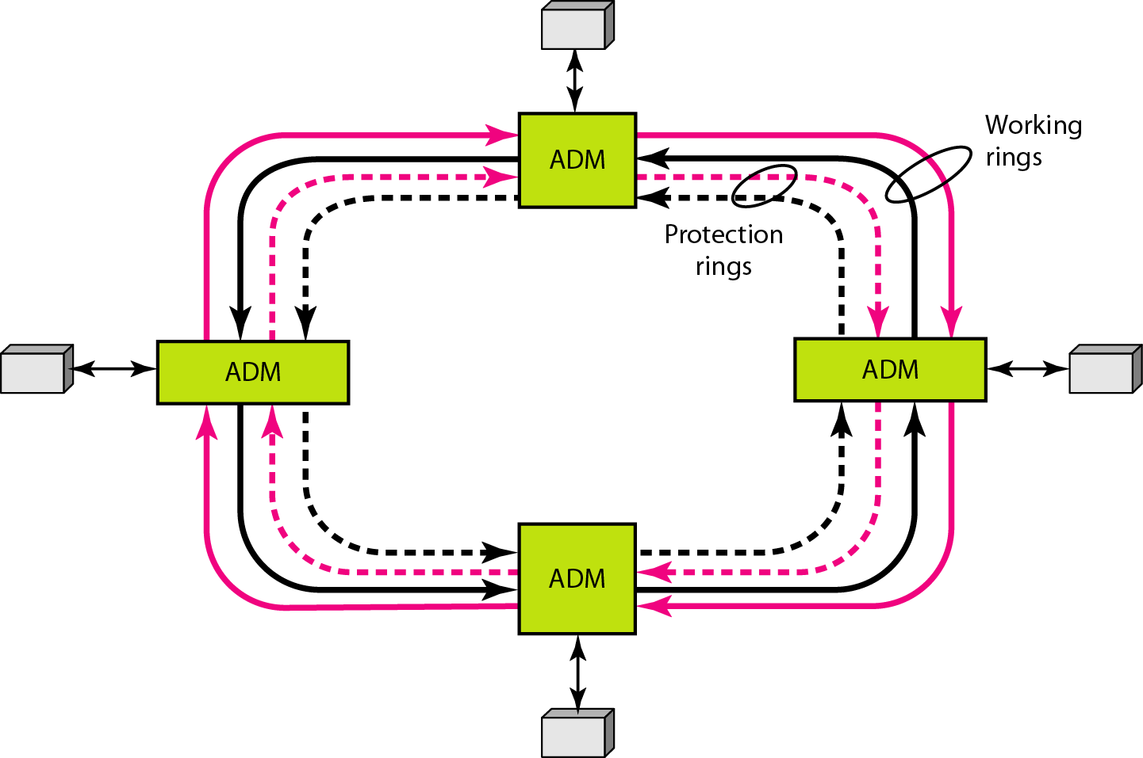
Figure 17.22 A bidirectional line switching ring

Slide 45
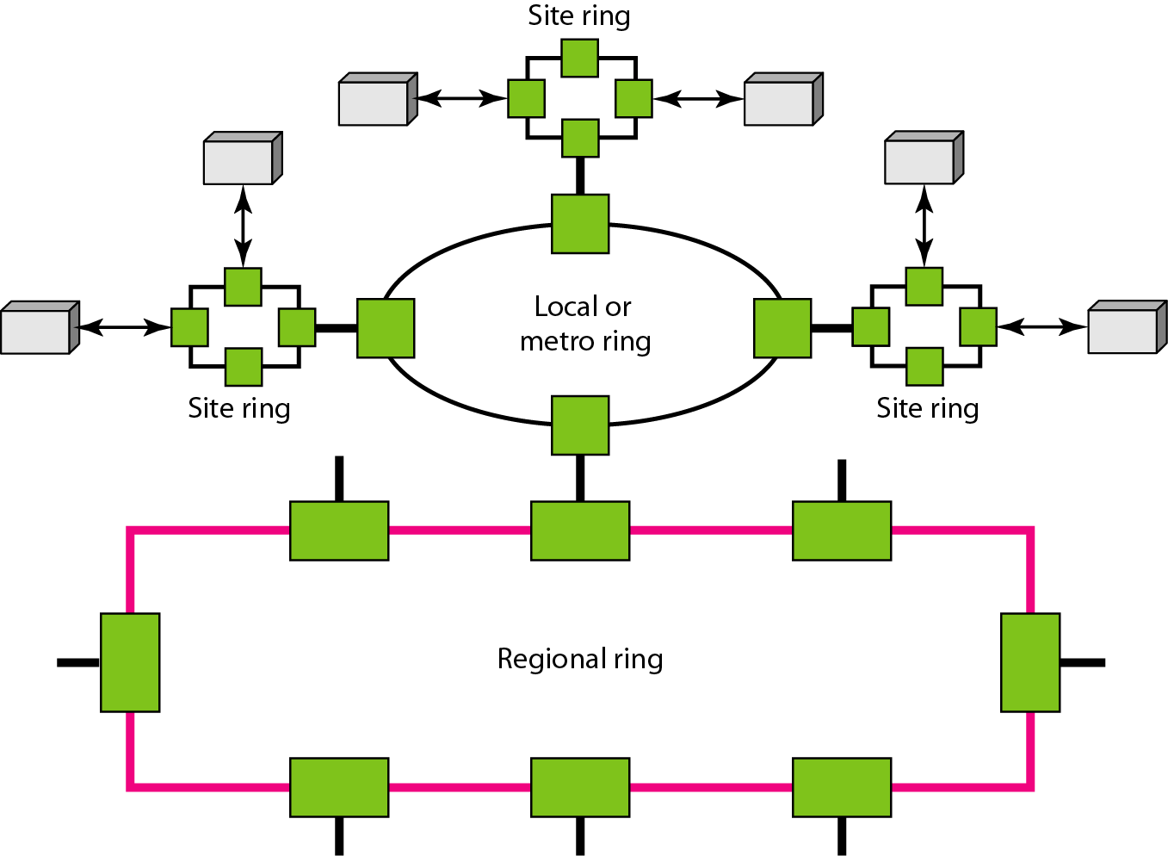
Figure 17.23 A combination of rings in a SONET network

Slide 46
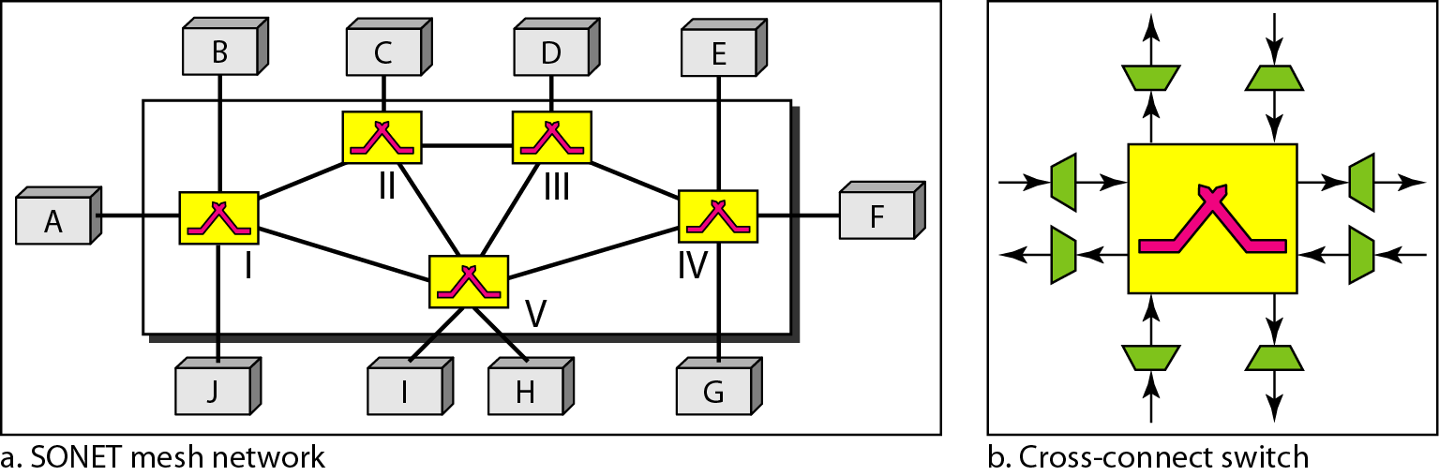
Figure 17.24 A mesh SONET network

Slide 47
17-6 VIRTUAL TRIBUTARIES
SONET is designed to carry broadband payloads. Current digital hierarchy data rates, however, are lower than STS-1. To make SONET backward-compatible with the current hierarchy, its frame design includes a system of virtual tributaries (VTs). A virtual tributary is a partial payload that can be inserted into an STS-1.
Topics discussed in this section:
Types of VTs

Slide 48
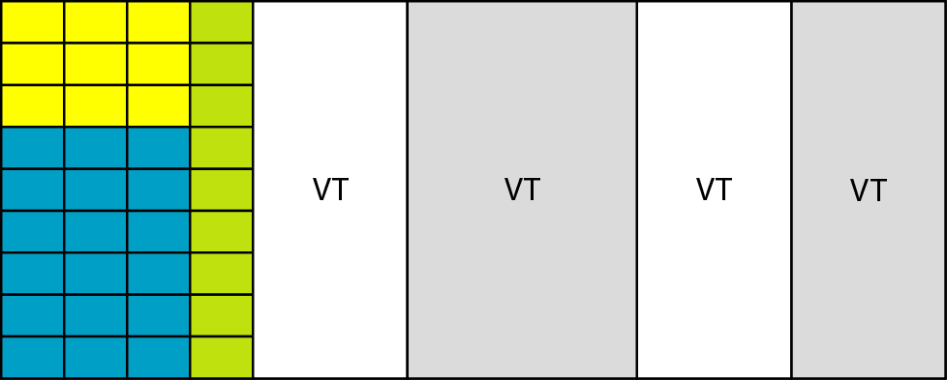
Figure 17.25 Virtual tributaries

Slide 49
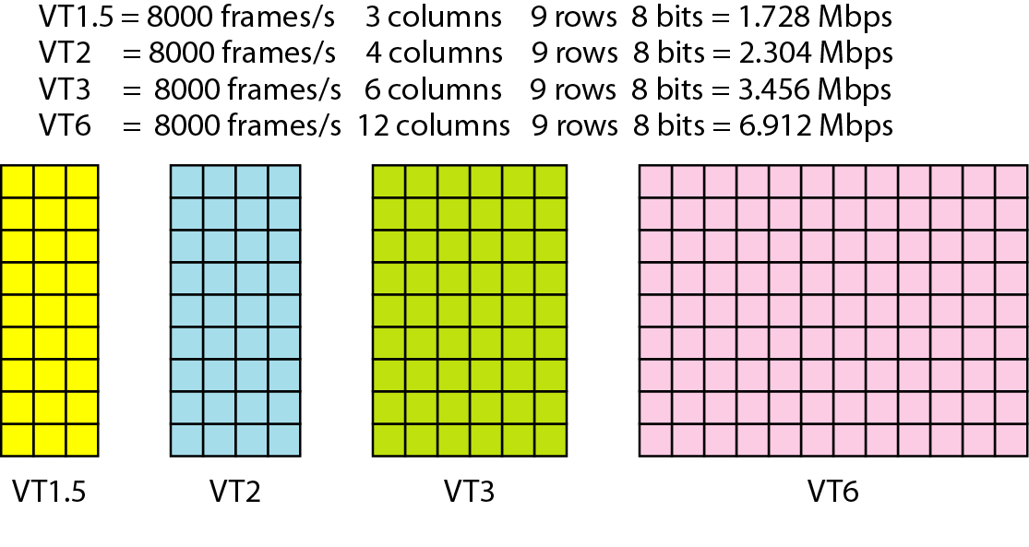
Figure 17.26 Virtual tributary types

Slide 50
Advantages of SONET
Today's carrier backbone networks are supported by synchronous optical network (SONET) and synchronous digital hierarchy (SDH) transmission technologies. SONET is the standard used in the United States and SDH is the standard used outside the United States.
SONET/SDH specification outlines the frame format, multiplexing method, and synchronization method between the equipment, as well as the specifying optical interface.
SONET/SDH will continue to play a key role in the next generation of networks for many carriers. In the core network, the carriers offer services such as telephone, dedicated leased lines, and Internet protocol (IP) data, which are continuously transmitted.
The individual data is not transmitted on separate lines; instead it is multiplexed into higher speeds and transmitted on SONET/SDH networks at up to 10 gigabits per second (Gbps). The following sections describe the need for SONET/SDH.

